Slide 1
MATLAB Tutorial
Kun-Yen Chiu

Slide 2
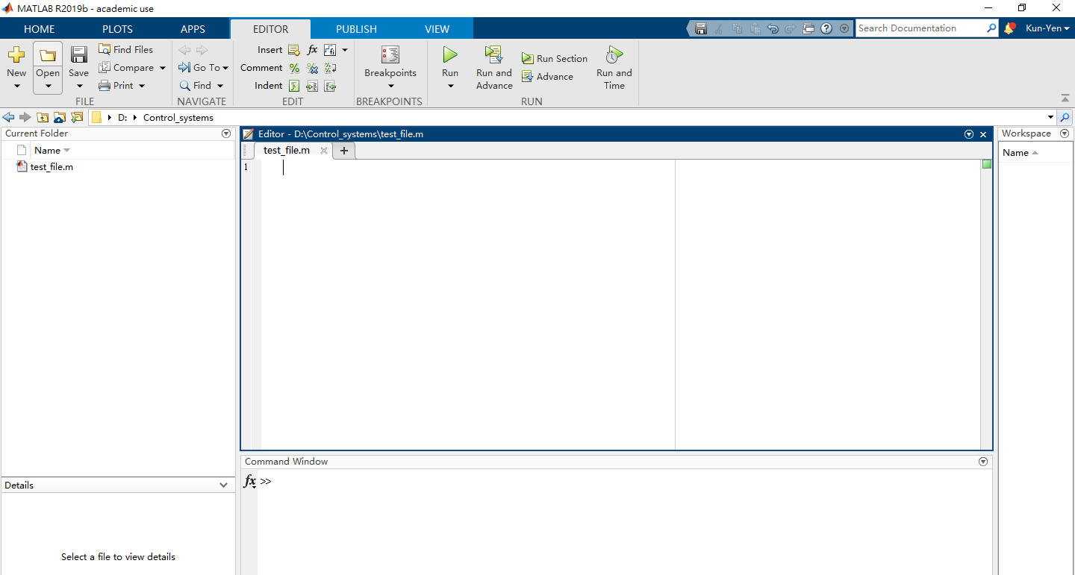
Click “New” to add new script
Save it as any location you prefer

Slide 3
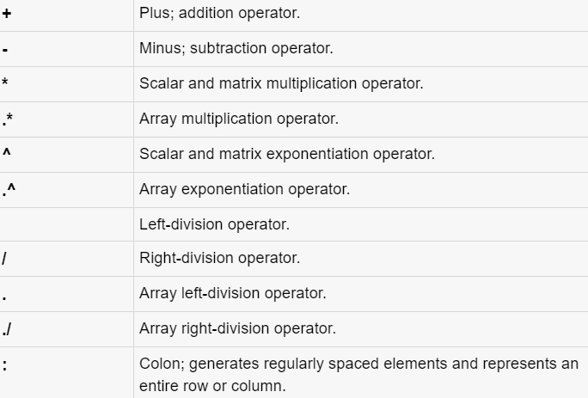
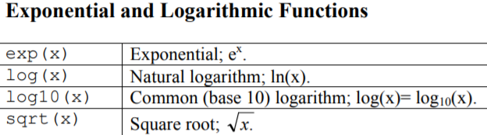
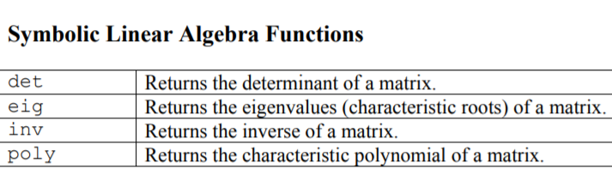
Basic Operator

Slide 4
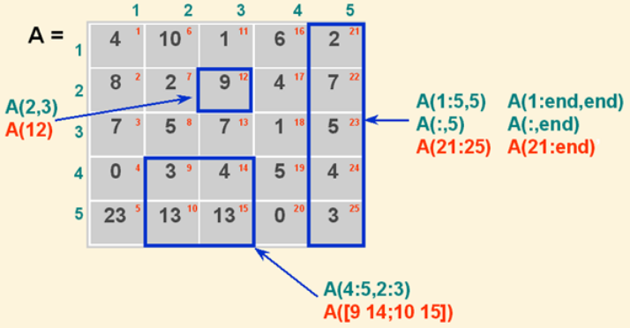
Matrix Representation
Noticed A(## , ##)
Column
(run vertical)
Row
(run horizontal)

Slide 5
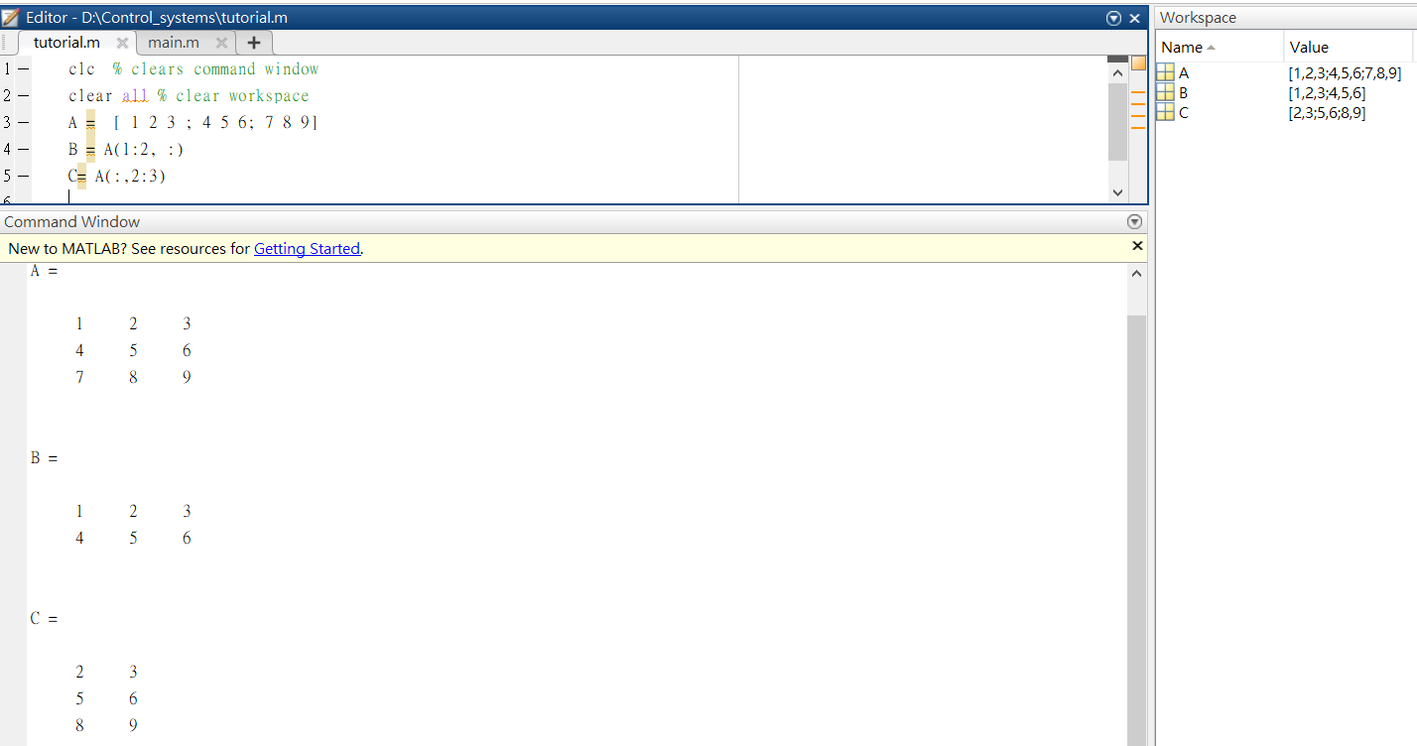
Exercise 1 – Create Matrix

Slide 6
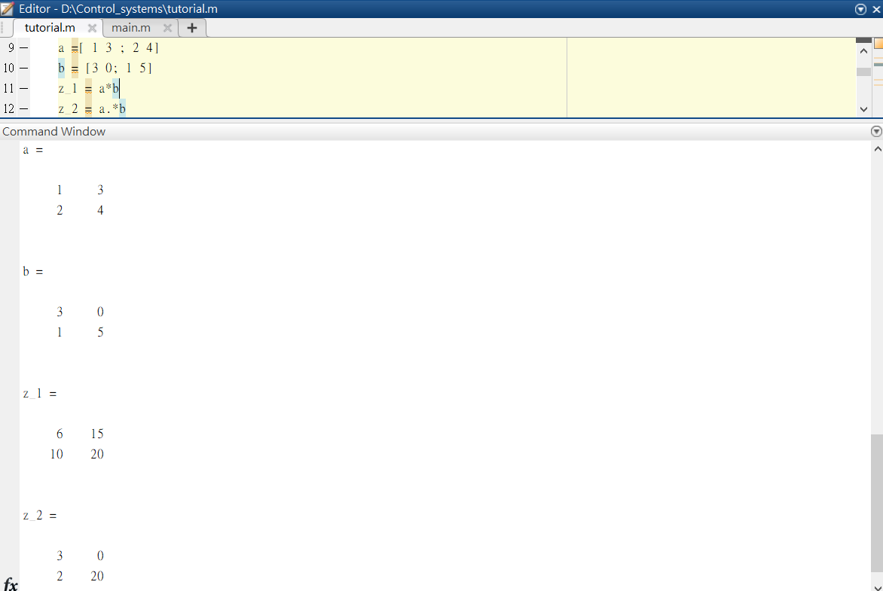
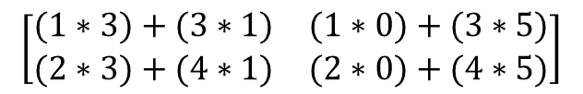

Exercise 2 – Matrix Multiplication
$$\left[\begin{matrix}(1∗3)+(3∗1) & (1∗0)+(3∗5) \\ (2∗3)+(4∗1) & (2∗0)+(4∗5)\end{matrix}\right]$$
$$\left[\begin{matrix}1∗3 & 3∗0 \\ 2∗1 & 5∗4\end{matrix}\right]$$

Slide 7
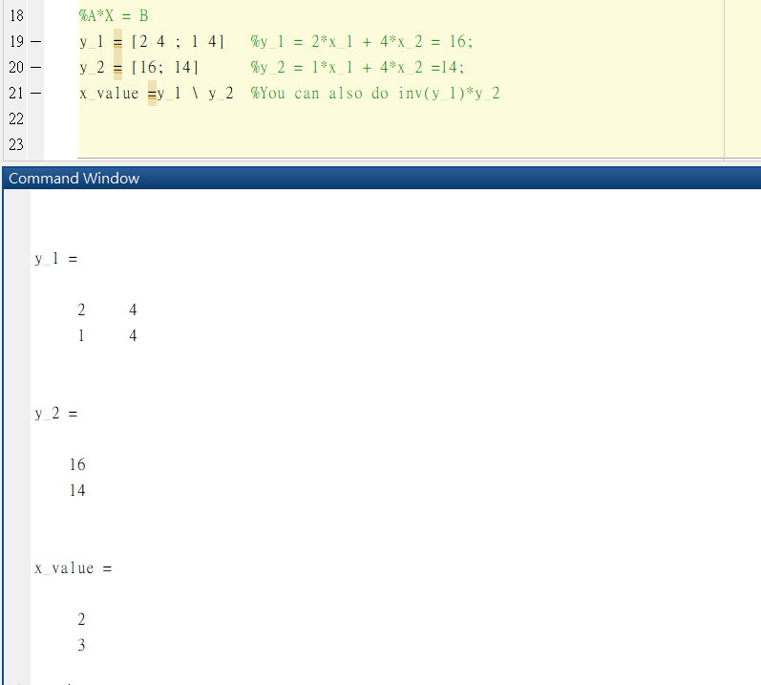



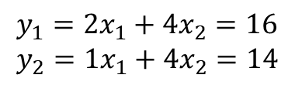
Exercise 3 – Solve Linear Equations
$$y_{1}=2x_{1}+4x_{2}=16 \\ y_{2}=1x_{1}+4x_{2}=14$$
$$y_{1}=\left[\begin{matrix}2 & 4 \\ 1 & 4\end{matrix}\right]$$
$$y_{2}=\left[\begin{aligned}16 \\ 14\end{aligned}\right]$$
x_value$=\left[\begin{aligned}2 \\ 3\end{aligned}\right]⇒x_{1}=2 , x_{2}=3$

Slide 8
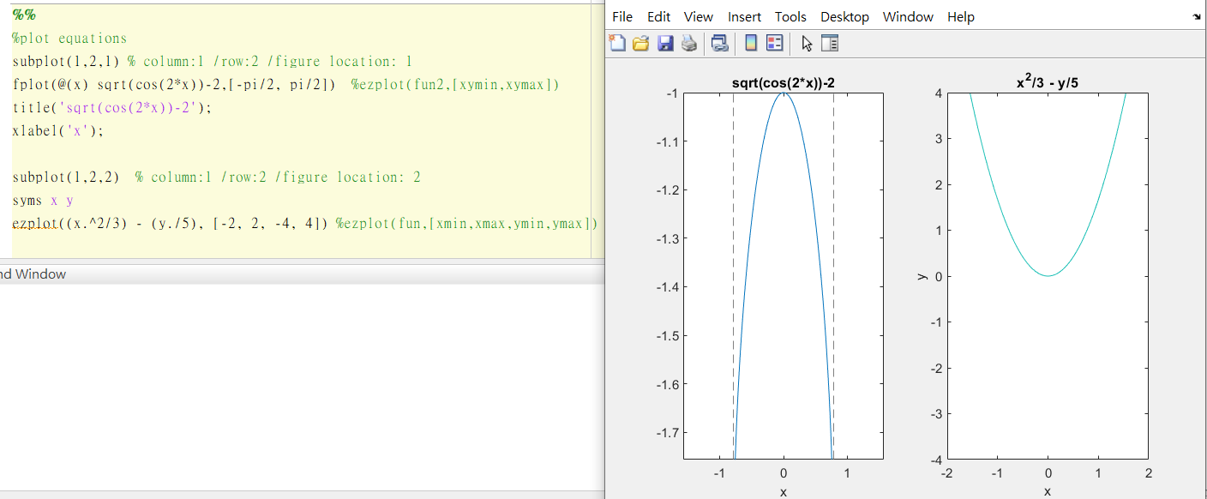


Exercise 4 – Plot equations
Eq1: $y=\sqrt{cos⁡(2x)}−2 , x∈[−\frac{π}{2},\frac{π}{2}]$
Eq2: $f\left(x,y\right)=\frac{x^{2}}{3}−\frac{y}{5} , (−2≤x≤2, −4≤y≤4)$

Slide 9
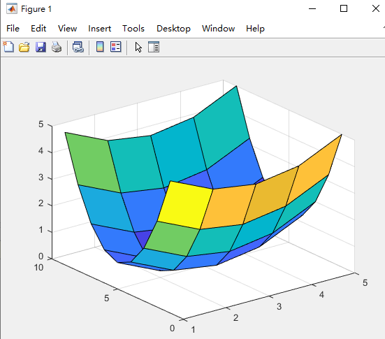
Plot f(x,y)
x =[-2:2] % value x range
y =[-4:4] % value y range
[xm ym] = meshgrid(x,y) % meshgrid: 2-D and 3-D grids
fxy = (xm.^2)/4 + ((ym.^2)/4) % Your Function fxy =f(x,y)
surf(fxy) % surf : Surface plot

Slide 10
Reference
https://www.tutorialspoint.com/matlab/index.htm

